Slide 1


Bacchus Winery
Amanda Wedergren
Miguel Fernandez
Jonah Aney
Justin Marucci

Slide 2

Team Intro
Welcome, we are the Blue Team. We are committed to finding the best solution for the Bacchus Winery case with a structured approach. We aim to find the most effective solution that increases and improves inventory management and enhances business operations. Each milestone has been an opportunity to refine our database management and Python scripting skills. We aim to create intelligent solutions to real-world problems.

Slide 3

Case Study Summary
Bacchus Winery is owned and operated by Stan and Davis Bacchus, two brothers who inherited the family business when their father passed away. Stan and Davis want to keep most things running as they were, retaining all of their existing staff.
Bacchus Winery grows the grapes to produce four different wines for distribution: Merlot, Cabernet, Chablis, and Chardonnay. The manager in charge of distribution, Maria, wants her distributors to be able to order online and track their status.
Stan and Davis are in charge of ordering supplies needed for production and distribution. They would like to order supplies over the internet and establish a more efficient way to track inventory.

Slide 4

Case Study Summary
The yearly reports need to include information about the state of inventory, distribution, and the employees.
Are all suppliers delivering on time?
Is there a large gap between expected delivery and actual delivery of inventory supplies?
Are all wines selling as expected?
Is one wine not selling?
Which distributor carries which wine?
During the last four quarters, how many hours did each employee work?

Slide 5
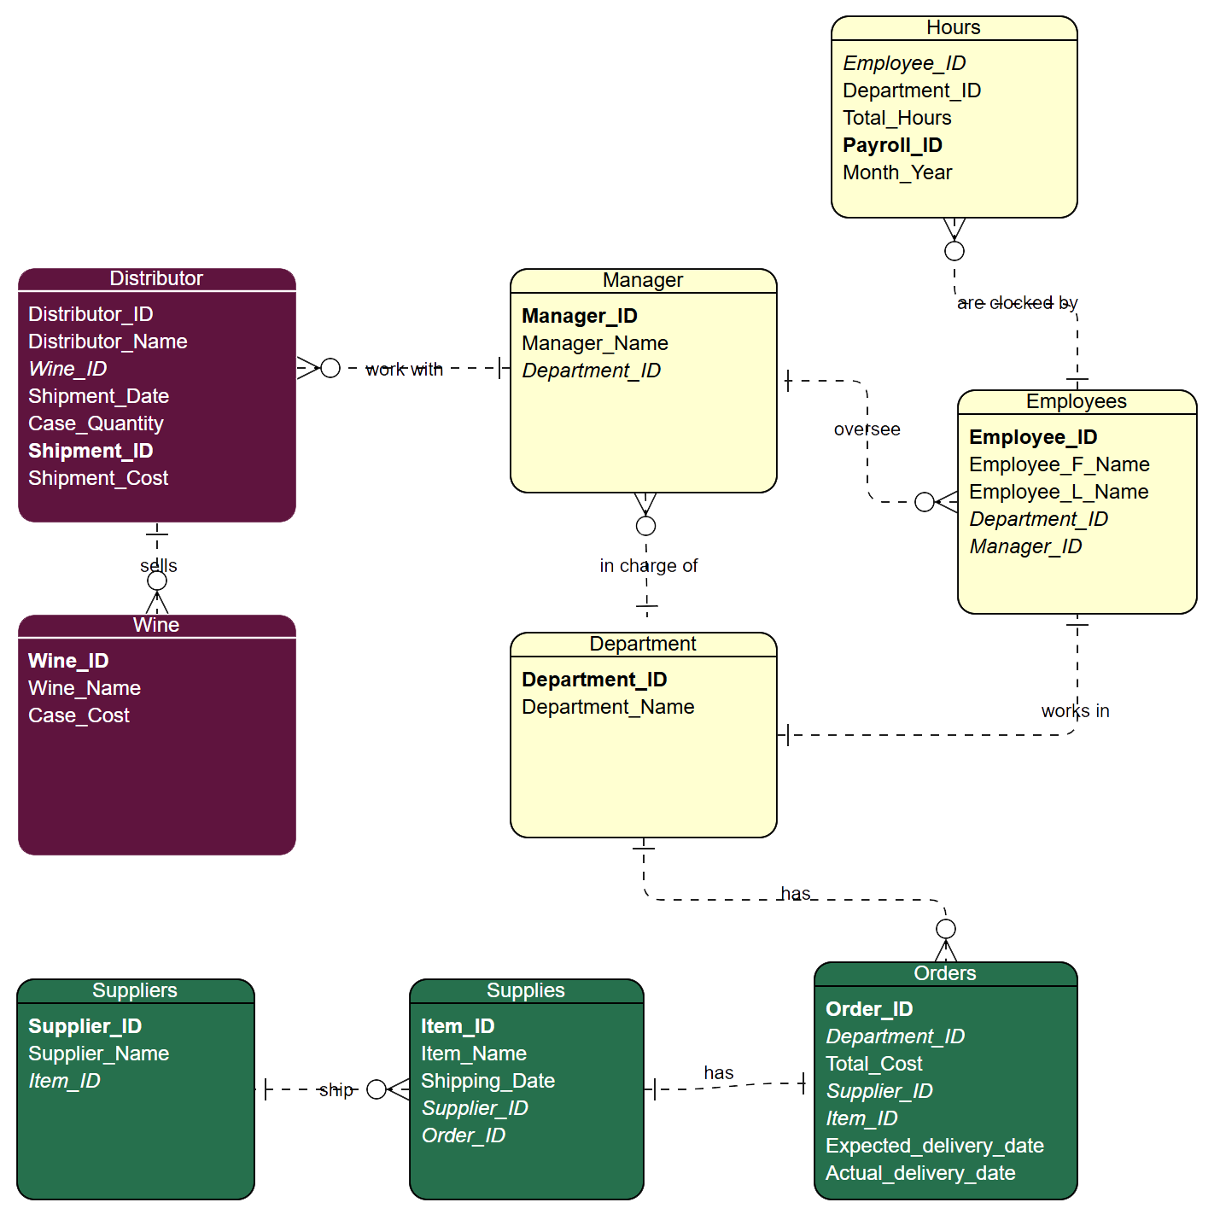

ERD

Slide 6
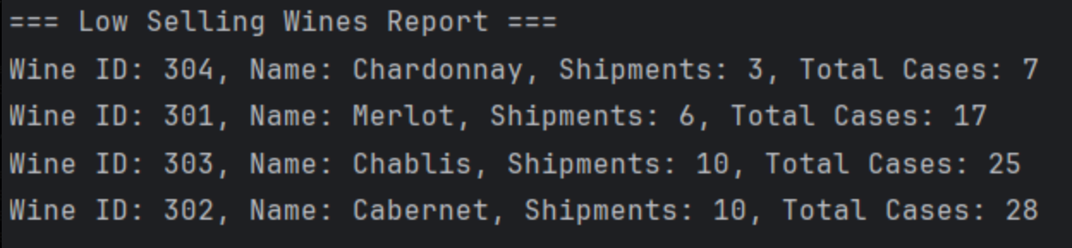
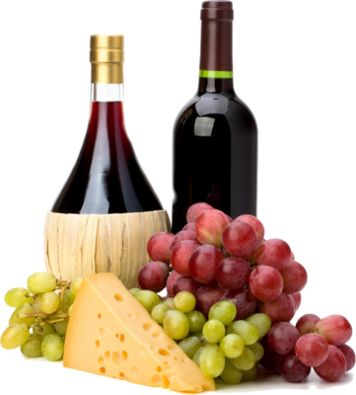
Wine Sales
The Wine Sales Report tells us which wines are selling by shipment quantity and total case sales. All 4 wines offered by Bacchus Winery are included. This report makes it easier to see which wines are selling. This will impact inventory, marketing, and sales efforts to maximize overall company profit.

Slide 7
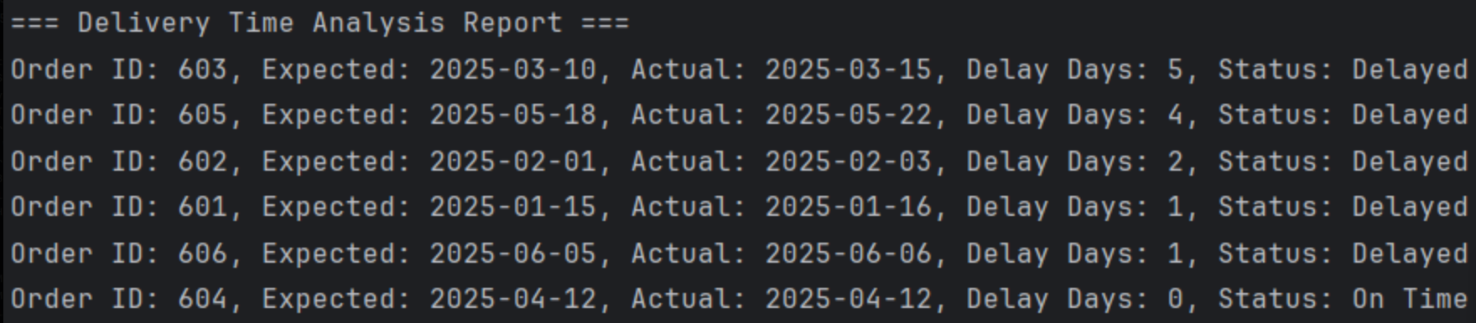
Delivery Time Analysis
The Delivery Time Analysis Report tracks the difference between wine orders' expected and actual delivery dates. It shows delays for specific orders, with the delay days and status of the deliveries. This will help with timely deliveries, better customer satisfaction, and distribution.

Slide 8
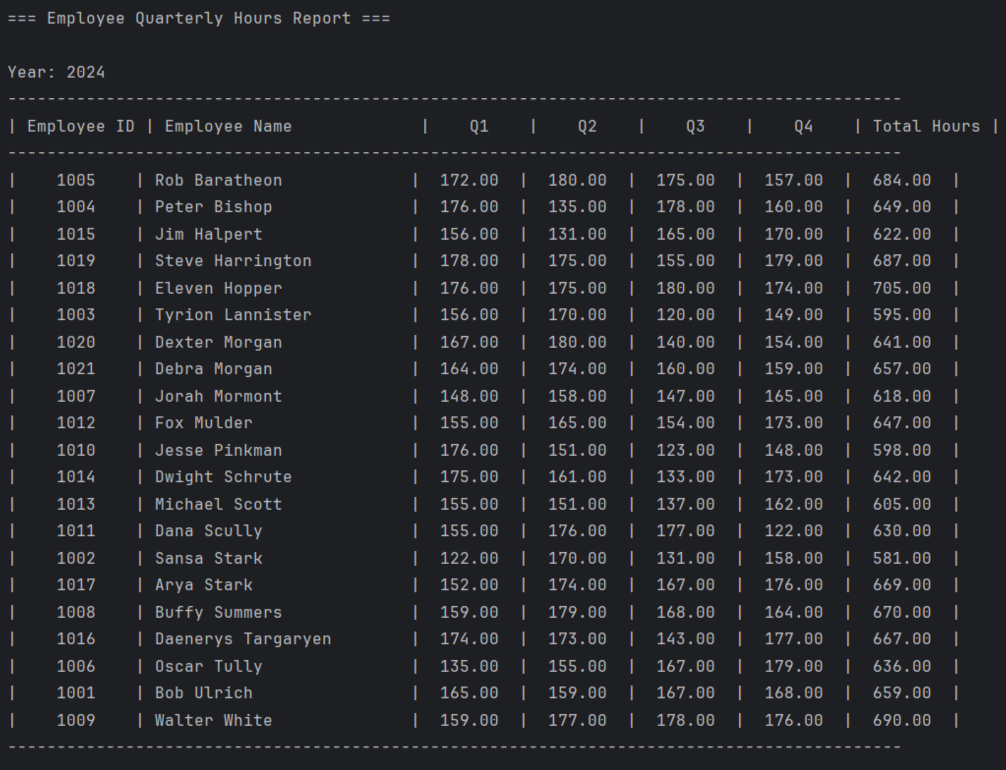
Employee Quarterly Hours
The Employee Quarterly Hours Report shows the total hours worked by everyone in Q1, Q2, Q3 and Q4 2024. It tracks productivity, determines the workload, and helps with payroll. Planning resources and ensuring fairness in work contribution among the team is necessary.

Slide 9

Assumptions
Hours worked by each employee are tracked and added on a monthly basis.
Online systems need to be implemented for ordering supplies and tracking distributions.
Distributors will place and manage their orders online.
Wine is sold in cases to each distributor.
Each case contains 12 bottles of wine.
Wine cost per case includes shipping costs to distributor.
Wines produced and sold are tracked using a unique Wine ID.
Each wine type sold is ordered and tracked by distributor for each wine type.
Each supply is ordered and tracked individually by supplier and order number.
Suppliers will provide shipping date and estimated delivery date when supply orders are placed.
Supply inventory will be tracked to ensure proper inventory levels for production.
Actual delivery date of supplies may not be the same as the expected delivery date.

Slide 10
Thank you for viewing our Bacchus Winery presentation!
Blue Team
Amanda Wedergren
Miguel Fernandez
Jonah Aney
Justin Marucci

